Slide 1
NY Real Estate Investment
Presented by,
Shelly Shtauber, Shubhra Bhatnagar, Rachel Solomon, Kevin Lacap

Slide 2
NYC Real Estate
Objective - Investing in Real Estate in NYC Boroughs as an investment strategy for both Rental and Sales properties for potential investors
Manhattan, Brooklyn, Queens, Bronx, Staten Island
Data Source
Attom API - Historical Sales Data
NYC Open Source - Data - GeoMapping, Zip to Neighborhood Mapping
www.health.ny.gov - ZIP Code Definitions of New York City Neighborhoods
Zillow - Historical Rent Data
https://github.com/ShakedRj/project_01_fintech

Slide 3
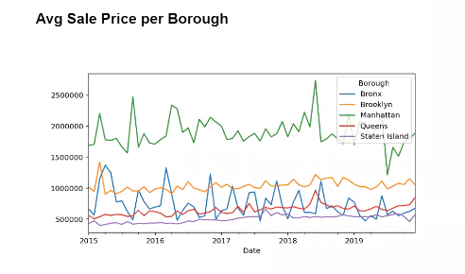
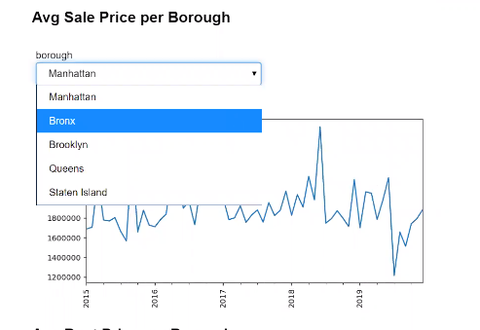

Slide 4
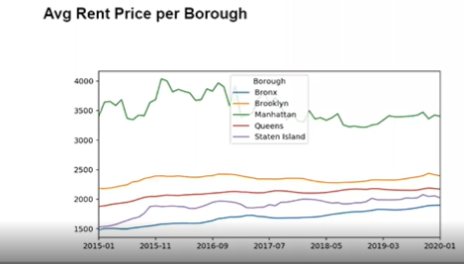
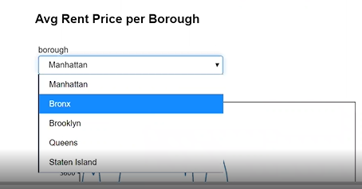

Slide 5
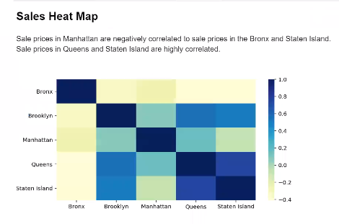

Slide 6
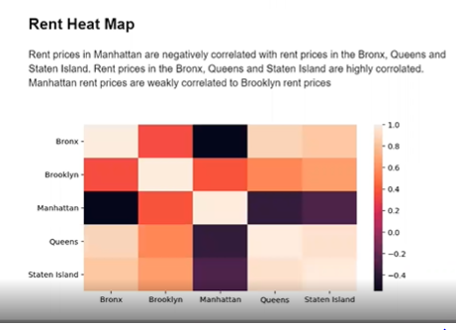

Slide 7
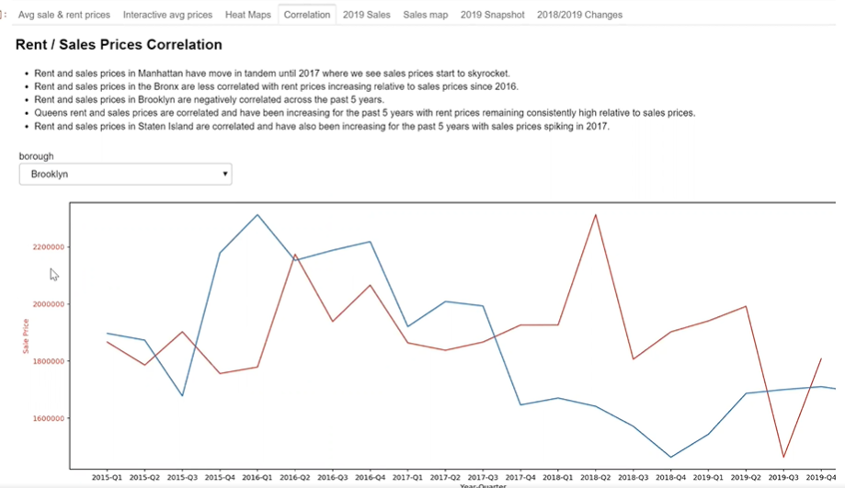

Slide 8
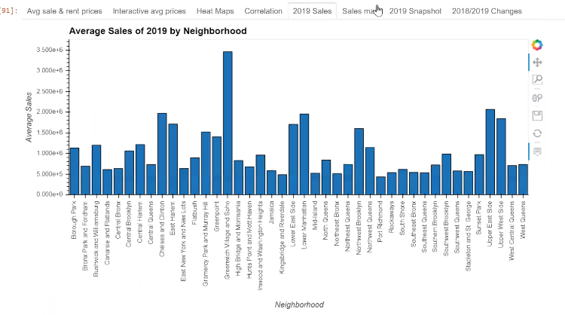

Slide 9
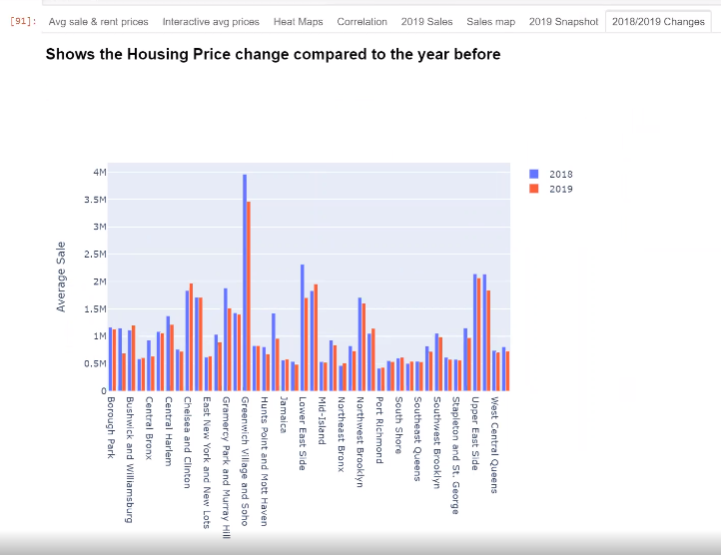

Slide 10
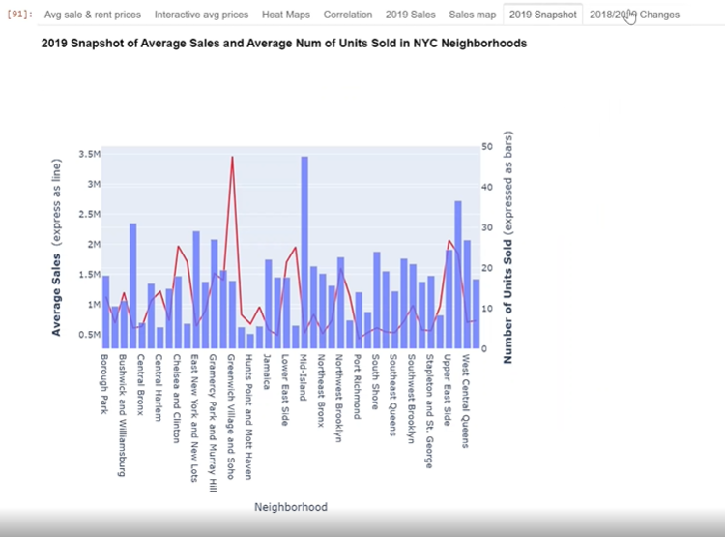


Slide 11
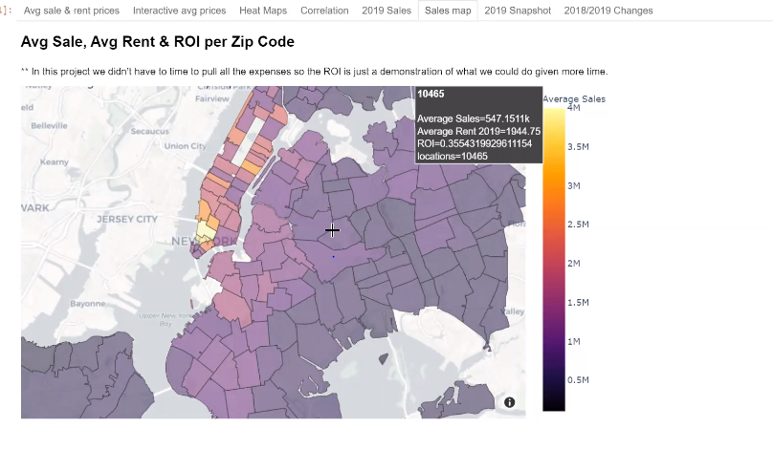
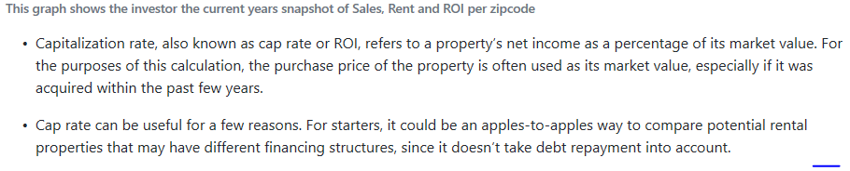

Slide 12
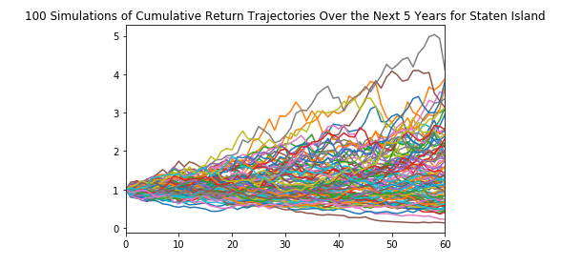
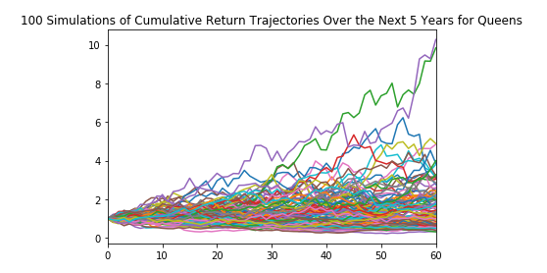
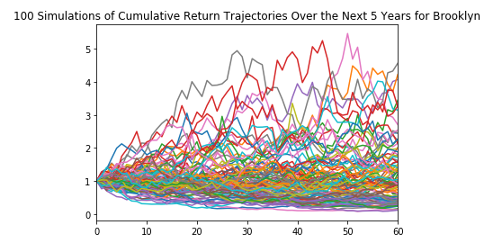
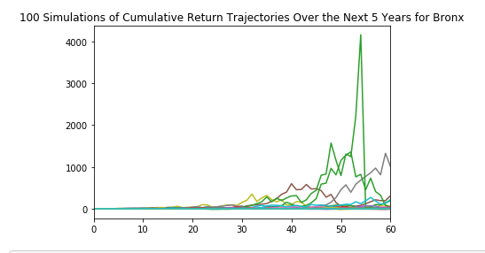
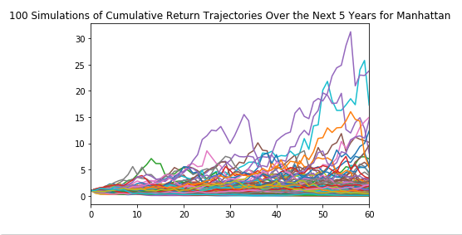
Monte Carlo – Sales Next 5yrs

Slide 13
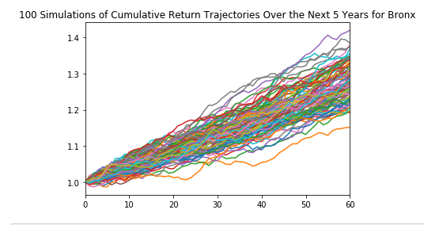
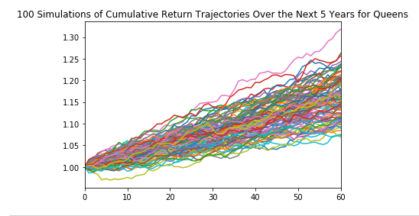
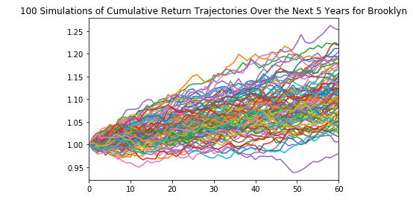
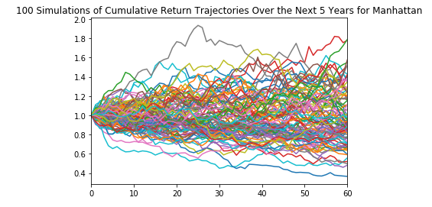
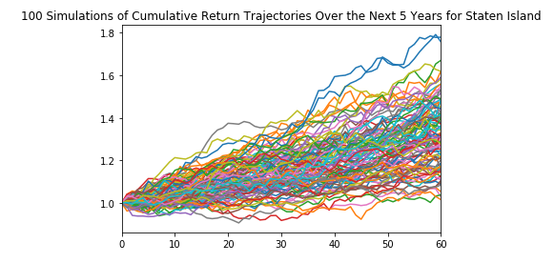
Monte Carlo – Rental Next 5yrs

Slide 14
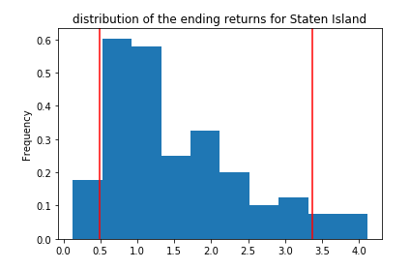
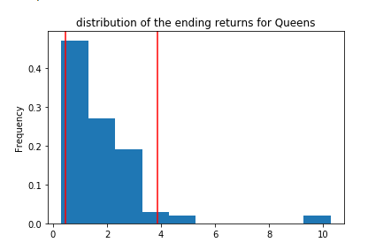
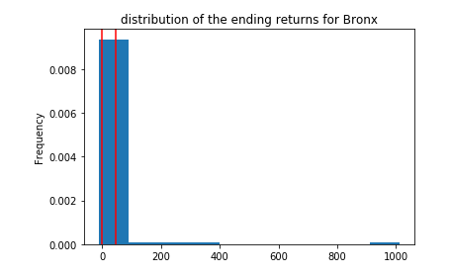
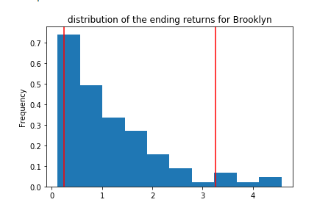
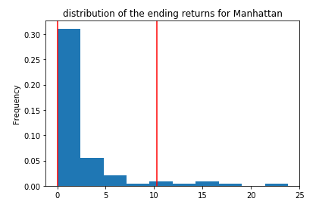
Confidence Interval for Sales

Slide 15
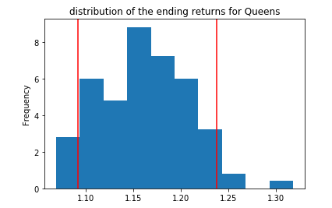
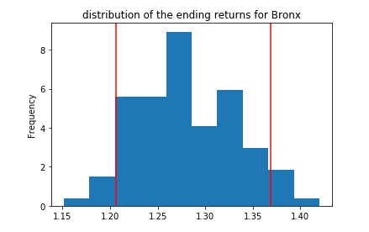
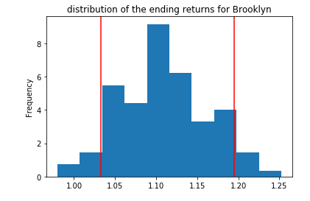
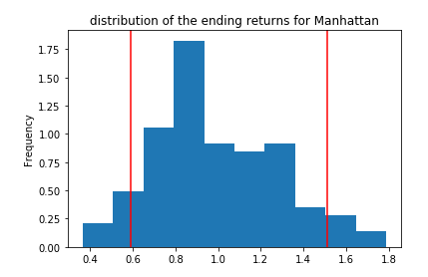
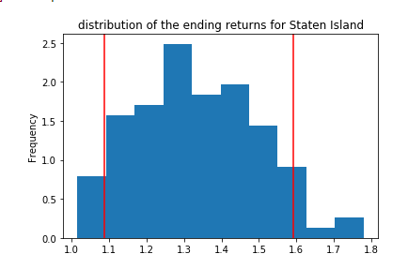
Confidence Interval for Rental

Slide 16
Conclusion
Almost everyone buys or rents homes however, its surprising how little is available to make the best decision except for some listing sites...This project will make people make the best decision and has a lot of potential especially when incorporate all the crime, demographics, school and pandemic data... If we had two more weeks we would have added additional inputs that investors typically use when modeling a real estate deal - Crime, school, demographics trend, transportation data etc...

Slide 17
Q&A

